Slide 1

BHEEMA INSTITUTE OF TECHNOLOGY & SCIENCE
ALUR ROAD, ADONI-51830, KURNOOL DIST, A.P.
A Project Presentation on
ALUMINUM PRICE FORECASTING – UNIVARIATE TIME SERIES FORECASTING MODEL USING CRISP-ML(Q) METHODS
Submitted By
B. THARANATH GOUD 212K1A0502
T.VAMSI 212K1A0555
K.ESHWAR 212K1A0522
B.VIKRAM 212K1A0506
T.BASAVARAJ 212K1A0554
Under the guidance of
Dr. D. William Albert, M.Tech., Ph.D.,
Professor & Head,
Department of Computer Science Engineering.

Slide 2
CONTENTS
Abstract
Introduction
Literature Survey
Existing System
Disadvantages of Existing System
Proposed System
Advantages of Proposed System
System Requirements
System Architecture
UML Diagrams
Output Screens
Conclusion
Future Enhancements
References

Slide 3
ABSTRACT
The project focuses on forecasting aluminum prices using historical daily price data.
A dataset containing 1,887 interpolated daily records from January 2020 onward was used for analysis.
Data preprocessing included handling missing values, ensuring consistent date formatting, and applying interpolation for continuity.
Time series modeling techniques such as Random Forest were explored to capture trends and seasonality.
The model performance was evaluated using metrics like RMSE and MAE to ensure prediction accuracy.
The forecasting results aim to support stakeholders in decision-making related to pricing, investment, and supply chain planning.
The study demonstrates the value of data-driven approaches in commodities forecasting, particularly for strategic metals like aluminum.

Slide 4
INTRODUCTION
Aluminum is a crucial industrial metal utilized in various sectors, including construction, transportation, and manufacturing. Its widespread use means that fluctuations in aluminum prices can significantly affect global markets and supply chains.
This project aims to develop a forecasting model using historical aluminum price data from January 2020, which includes 1,887 daily interpolated records
The findings are intended to facilitate data-driven decision-making in commodity markets, particularly in planning and risk mitigation strategies related to aluminum pricing.

Slide 5
LITERATURE SURVEY
MACHINE LEARNING
The project aims to forecast future aluminum prices using historical daily data.
Aluminum pricing is vital for industries like manufacturing, construction, and finance.
The dataset consists of 1,887 daily records, starting from January 2020.
Time series forecasting techniques used include Random Forest, ARIMA, and LSTM neural networks.
Model performance is evaluated using accuracy metrics like RMSE (Root Mean Square Error) and MAE (Mean Absolute Error).

Slide 6
CRISP-ML(Q)
Cross Industry Standard Process for Machine Learning with Quality Assurance.
Recent research in commodity price forecasting emphasizes the power of time series models, especially ARIMA, SARIMA, and Exponential Smoothing. The CRISP-ML(Q) methodology has emerged as a quality-driven lifecycle for machine learning projects, ensuring reliable model development, monitoring, and continuous improvement. Studies show that univariate models like Holt-Winters perform well for stable price patterns, while hybrid approaches may be needed for volatile commodities.

Slide 7
EXISTING SYSTEM
Aluminum price forecasting is primarily done using manual methods, such as Excel trendlines.
Basic statistical tools are used with limited automation.
Many industries still depend on human judgment to interpret market trends.
Delays in decision-making.
Human errors in analysis and predictions.
Missed opportunities due to inefficient pricing strategies.

Slide 8
DISADVANTAGES OF THE EXISTING SYSTEM
Prone to human error
Not scalable or automated
No predictive capability for future prices
Limited use of historical patterns
No real-time updates or alert mechanisms

Slide 9
PROPOSED SYSTEM
Introduces a time series-based forecasting system using univariate models.
Utilizes historical monthly aluminum price data for analysis.
Applies statistical models such as:
ARIMA (AutoRegressive Integrated Moving Average)
Holt-Winters Exponential Smoothing
Outputs future price forecasts with improved accuracy.
Model development includes:
Training, validation, and testing using industry-standard practices.
Reduced human error in price forecasting.

Slide 10
ADVANTAGES OF THE PROPOSED SYSTEM
Automated and scalable solution.
Reduces human dependency.
Uses historical patterns for forecasting.
Produces accurate, short- and long-term price predictions.
Helps businesses plan better and reduce financial risk.

Slide 11
SYSTEM REQUIRMENTS
Hardware Requirements
Processor: Minimum Intel Core i3
Memory: 4GB RAM (16GB recommended for large datasets)
Storage: 500GB SSD (for data storage and processing)
Graphics: Integrated graphics sufficient (dedicated GPU optional for advanced machine learning)
Software Requirements
Operating System: Windows 10/11
Python: Version 3.x
Development Environment: Jupyter Notebook, PyCharm/Google Colab

Slide 12
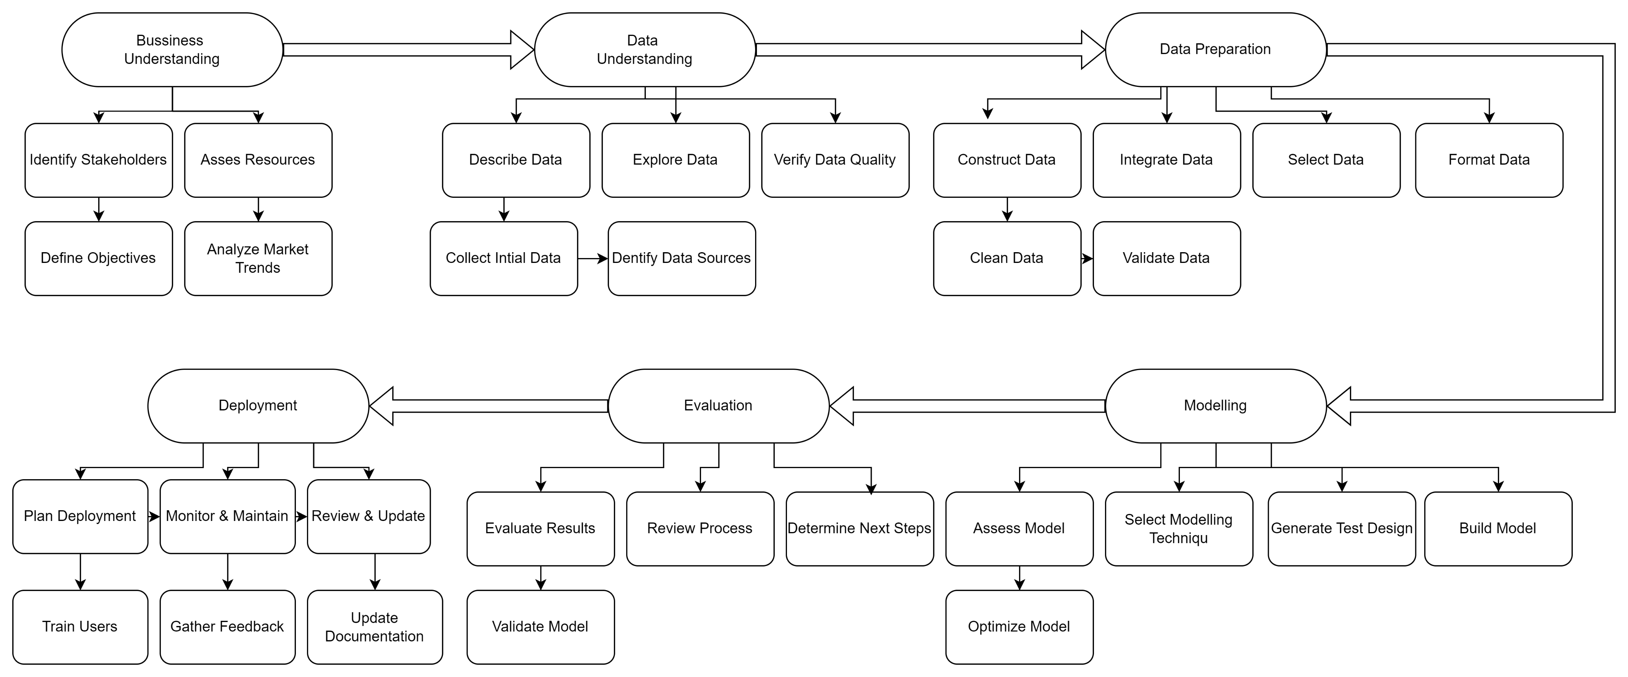
SYSTEM ARCHITECTURE

Slide 13
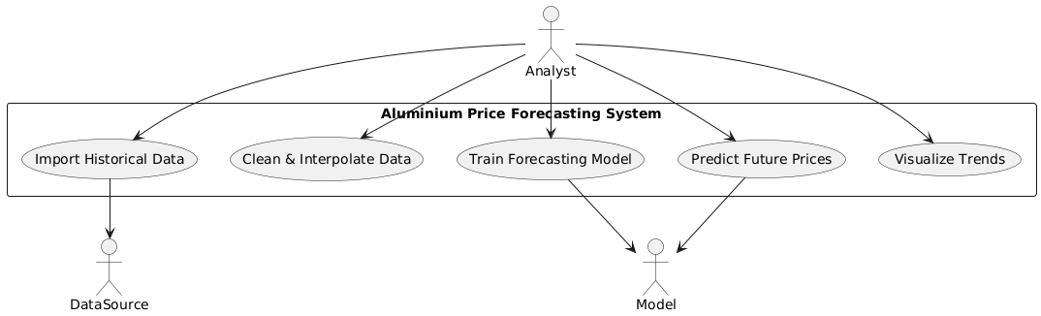
UML DIAGRAMS FOR PROPOSED SYSTEM
1.Use Case diagram

Slide 14
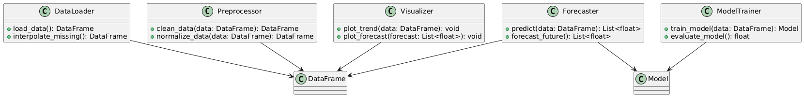
2.Class Diagram

Slide 15
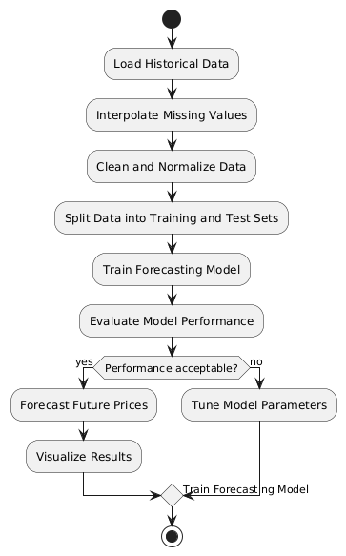
3.Activity Diagram

Slide 16
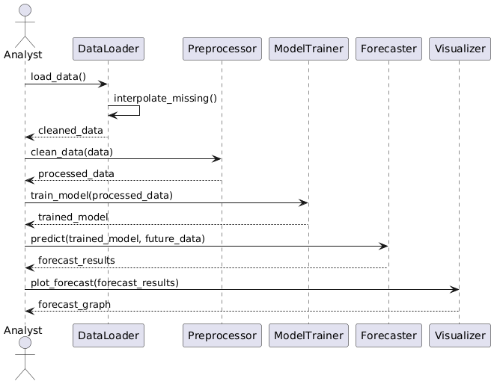
4.Sequence Diagram

Slide 17
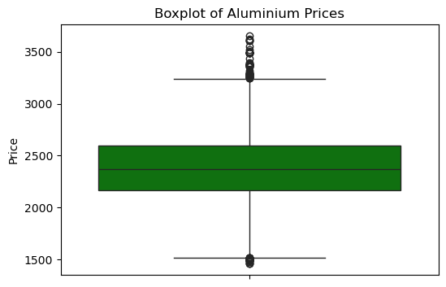
OUTPUT
Before Data Preprocessing

Slide 18
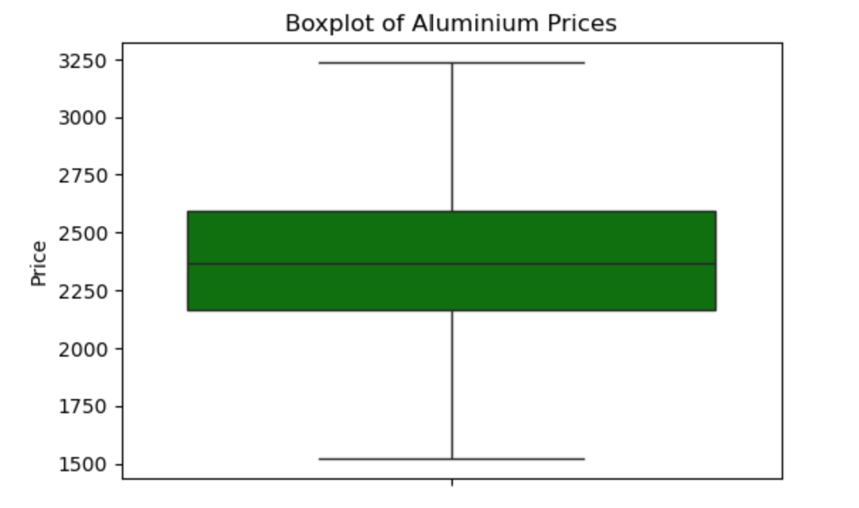
After Data Preprocessing

Slide 19
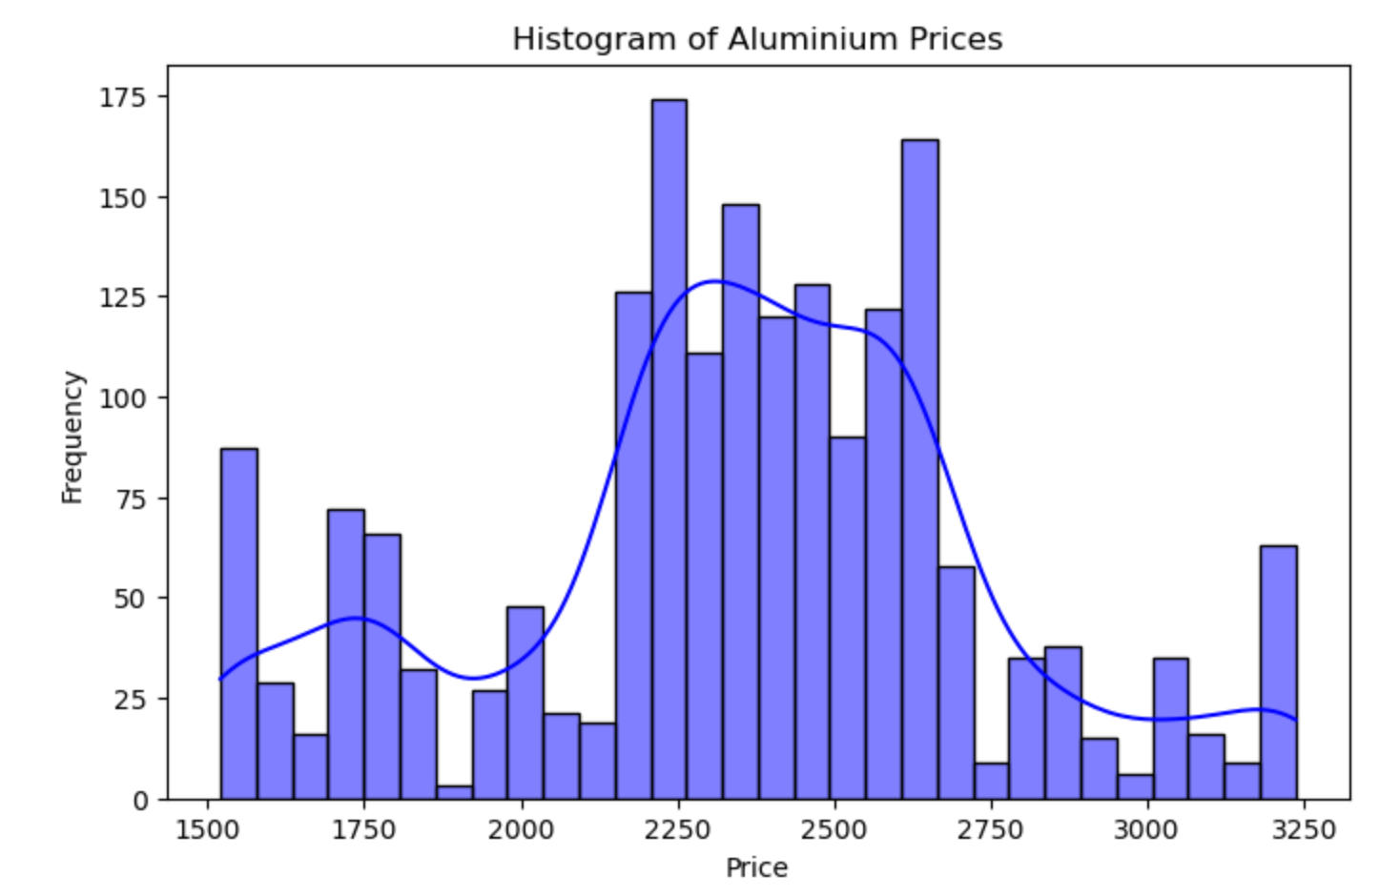

Slide 20
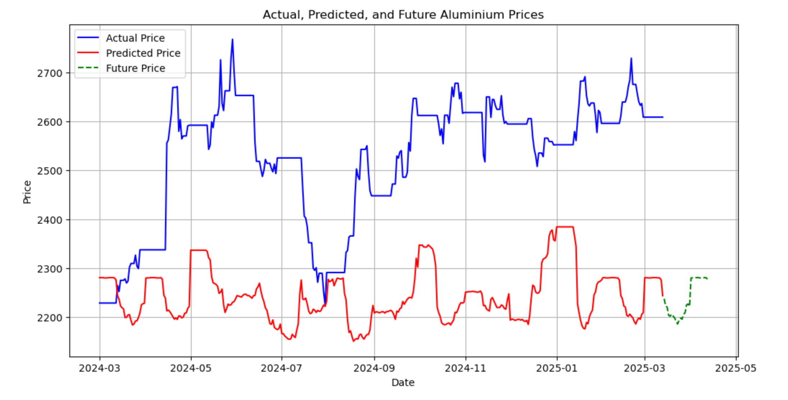

Slide 21
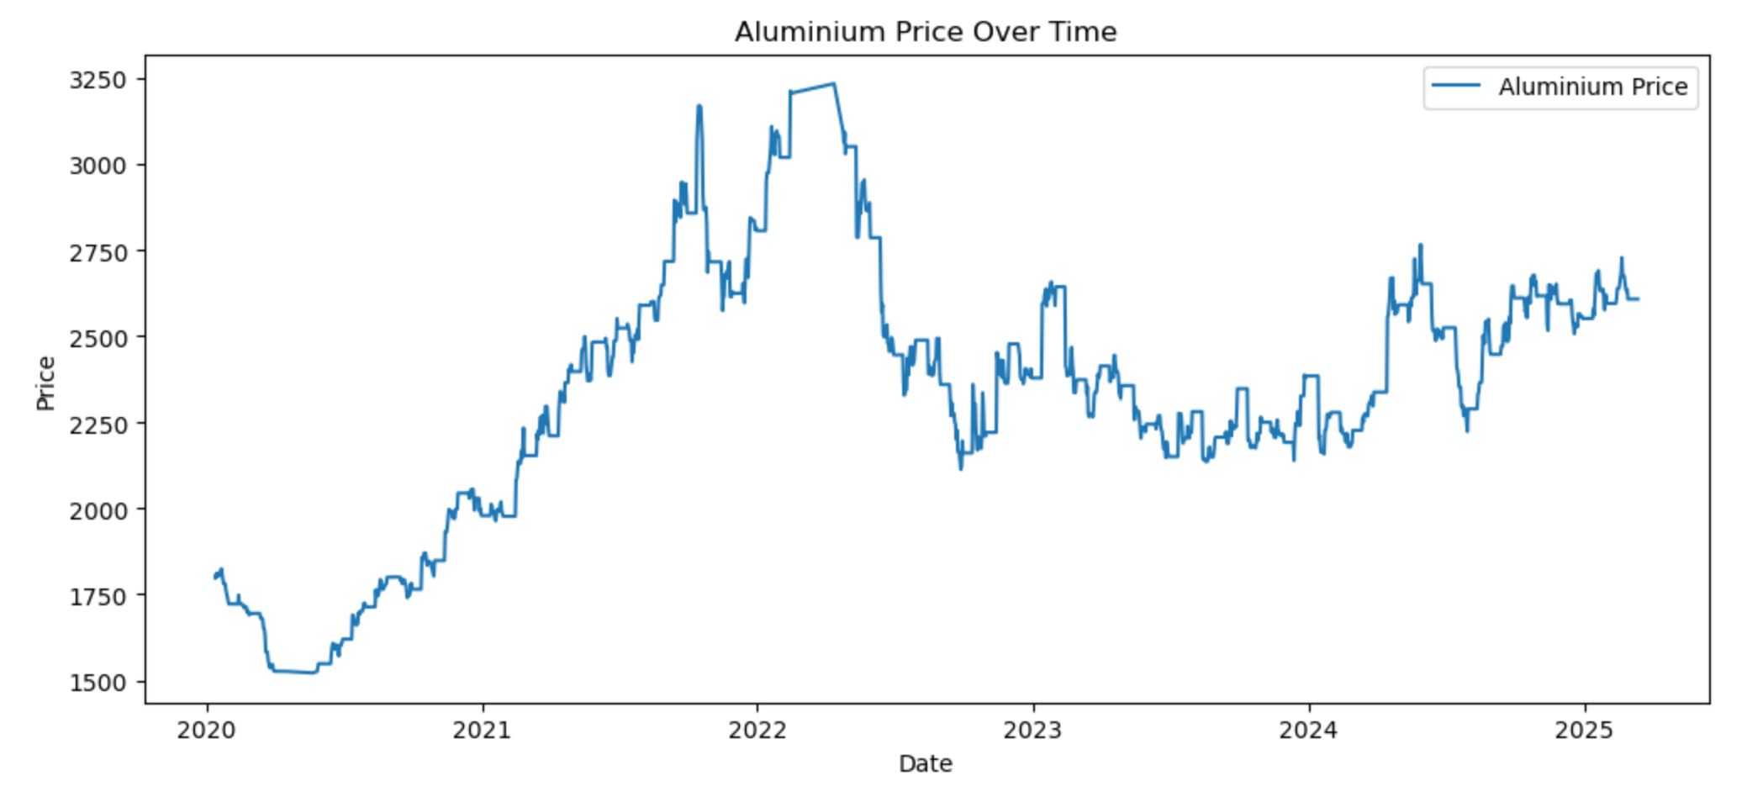

Slide 22
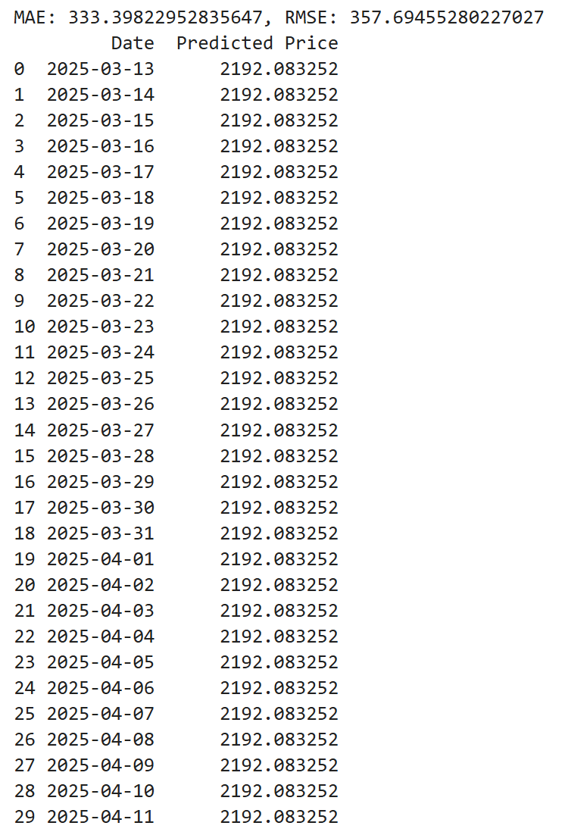

Slide 23
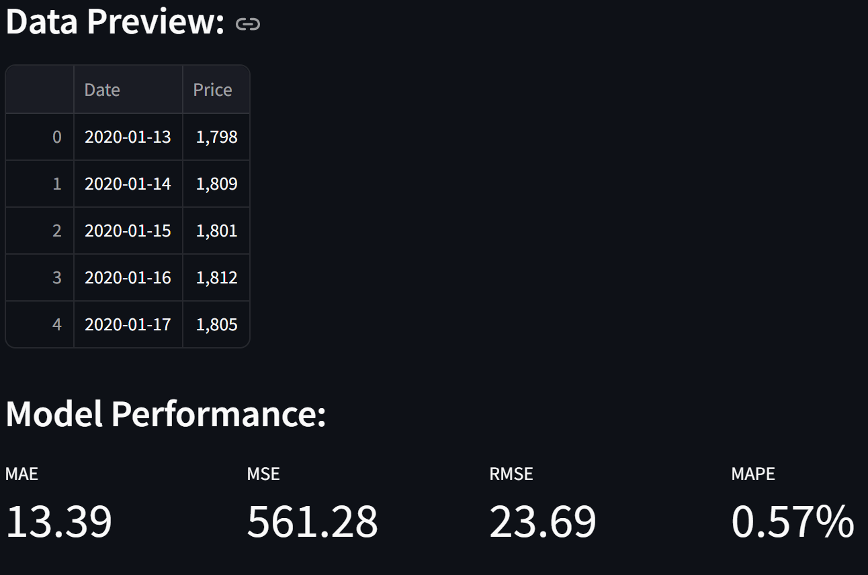

Slide 24
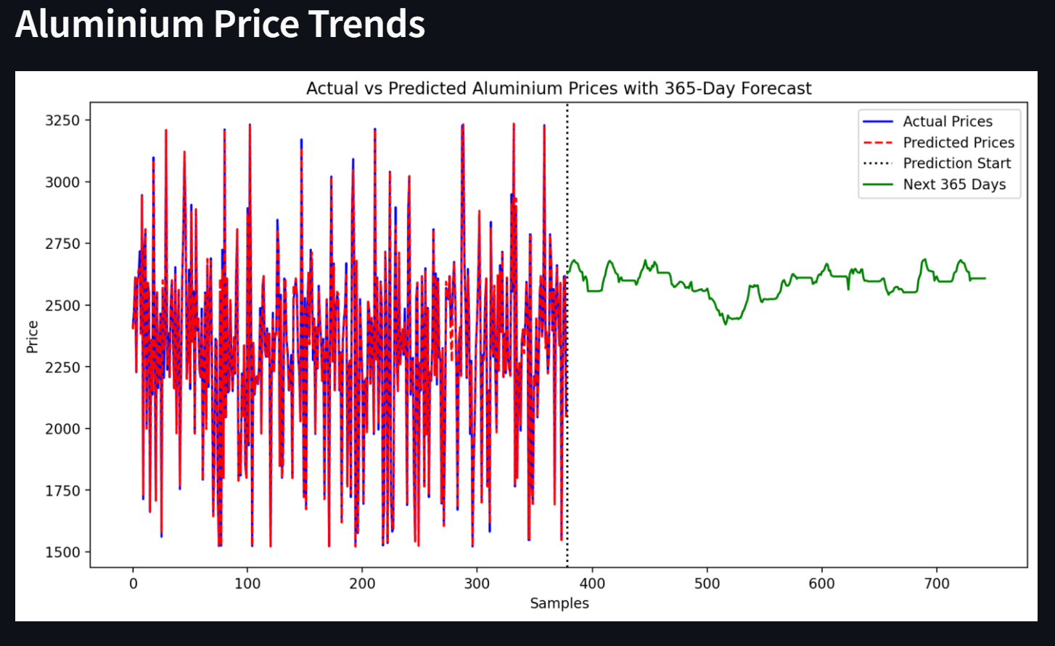

Slide 25
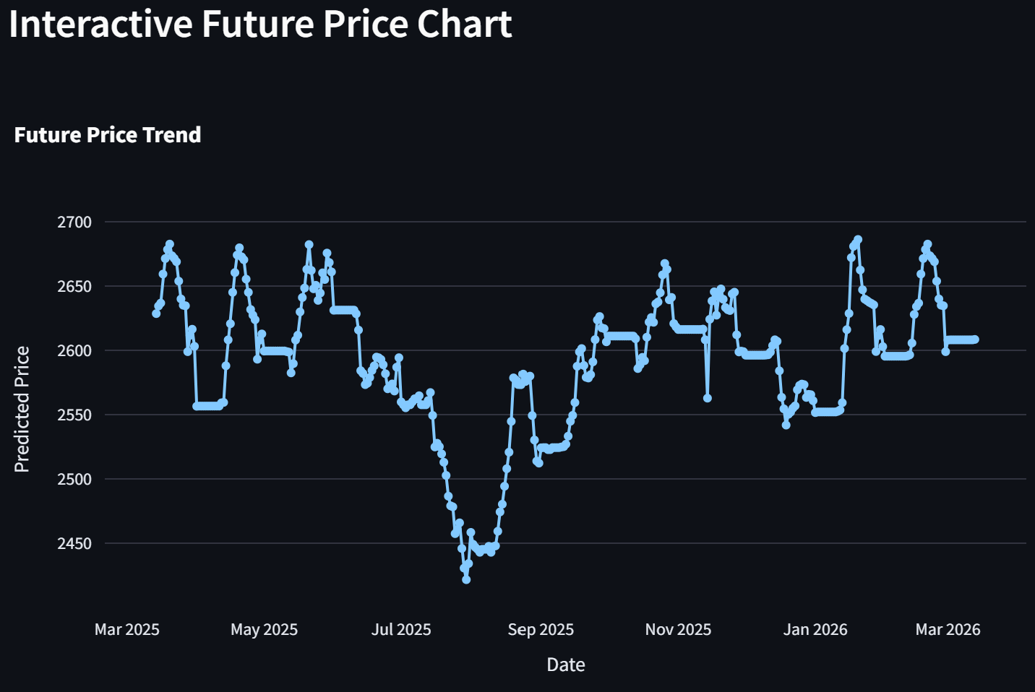

Slide 26
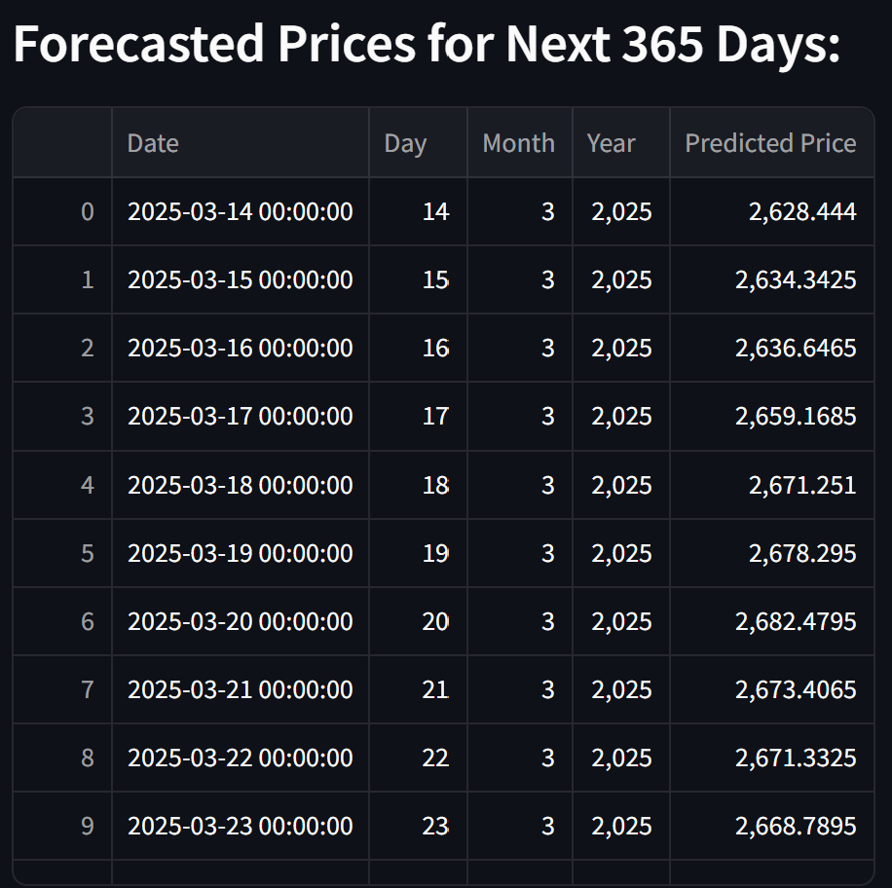

Slide 27
CONCLUSION
In this project, we successfully analyzed historical aluminum price data and developed forecasting models to predict future price trends. By leveraging time series analysis and machine learning techniques, we were able to uncover underlying patterns and seasonality in aluminum pricing. The resulting forecasts provide valuable insights that can inform decisions for industries and investors regarding procurement, budgeting, and strategic planning.
While the models performed reasonably well, future improvements could include incorporating external economic indicators, news sentiment, or global market trends to enhance forecasting accuracy further. Overall, this project demonstrates the practical value of data-driven forecasting in the commodities market.

Slide 28
FUTURE ENHANCEMENT
Real-time Data Integration
Connect to live data sources via APIs for up-to-date forecasting.
Advanced Modeling & Auto ML
Implement multiple forecasting algorithms with automated model selection.
Anomaly Detection & Alerts
Identify unusual trends or price spikes to aid in risk management.
Automated Reporting
Generate periodic summary reports of forecast results and model performance.

Slide 29
REFERENCES
Data Collection
1. Sources:
Market Prices: London Metal Exchange (LME), Bloomberg, Yahoo Finance
Economic Indicators: IMF, World Bank, OECD
Supply & Demand: International Aluminum Institute, USGS
Formats: CSV, JSON, APIs, SQL databases
Handling Missing Values
Identify missing values using .isnull().sum().
Use ML-based imputation if multiple features are missing.
Microsoft Azure. (n.d.).Times series forecasting on AZURE. Retrieved from https://learn.microsoft.com
– Provides an overview of deploying forecasting models on cloud infrastructure.
OECD. (2023). Main Economic Indicators. Retrieved from https://www.oecd.org/statistics/mei/.html
– Source for incorporating macroeconomic data into forecasting models.

Slide 30


